Slide 1
UNIT 2

Slide 2
UNIT 2
J2EE and Web Development: Exploring enterprise architecture types, Describing EE6 containers, Types of Servers in J2EE Applications, Exploring the HTTP protocol: Describing HTTP requests, Introducing web applications: Describing components of a web application, Describing structure, Describing web containers, Exploring web architecture models: Model-1 architecture, Model-2 architecture and MVC architecture. [CO1]

Slide 3
Enterprise Architecture
Enterprise architecture helps to understanding the structure of an application and can be divided into 3 fundamental layers:
  The presentation layer – It is a User interface
    Purpose: Interface between the user and the application.
    Responsibilities:
      Displays information to the user
      Accepts user input (forms, buttons, menus)
    Examples: HTML/CSS pages, JSP files, JavaFX, Angular, React, etc.

Slide 4
  The business logic layer – The logic of the application in implemented here
    Purpose: Contains the application's core logic.
    Responsibilities:
      Enforces business rules (e.g., calculating discounts, validating orders)
      Acts as an intermediary between UI and data
    Examples: Java classes, Spring Services, EJB components
  The data storage and access layer – Helps business application to read and store the data
    Responsibilities:
      Connects to databases or file systems
    Examples: JDBC code

Slide 5
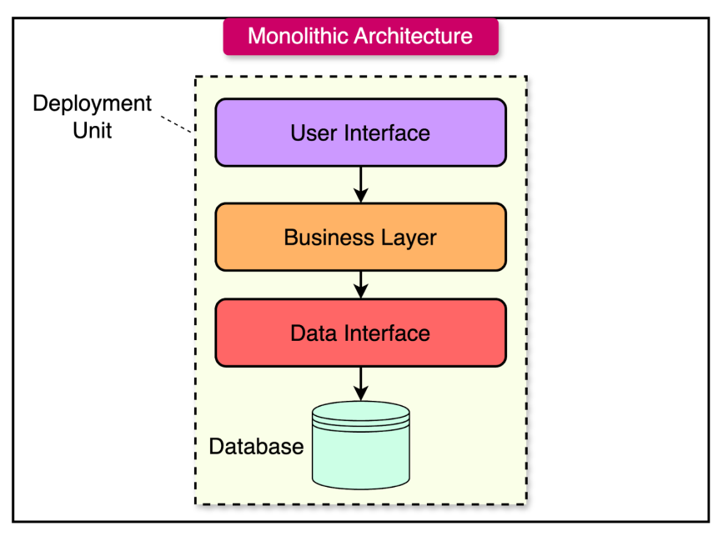
Exploring Enterprise Architecture Types
Single-Tier Architecture (Monolithic)
  Everything in one layer: Presentation logic, business logic and data access layers present in the same computing architecture.

Slide 6
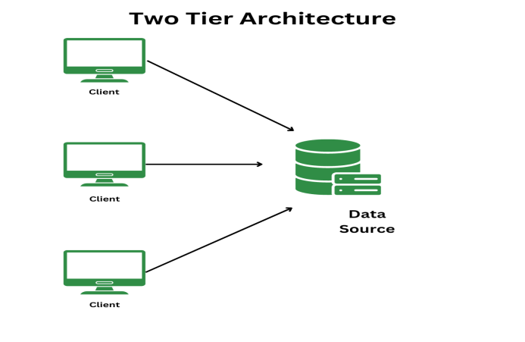
2-tier Architecture:
Two-tier architecture is a type of software architecture where the application is divided into two layers:
  Tier 1: Client Tier: User Interface (UI) i.e., presentation logic + Business Logic
  Tier 2: Server Tier: Database server (Data storage and access)
    // Client Side
    Connection conn = DriverManager.getConnection(
    "jdbc:mysql://localhost:3306/school", "root", "password");
    Statement stmt = conn.createStatement();
    ResultSet rs = stmt.executeQuery("SELECT * FROM students");
In two-tier, the application logic is either hidden inside the user interface on the client or within the database layer on the server side (or both).

Slide 7
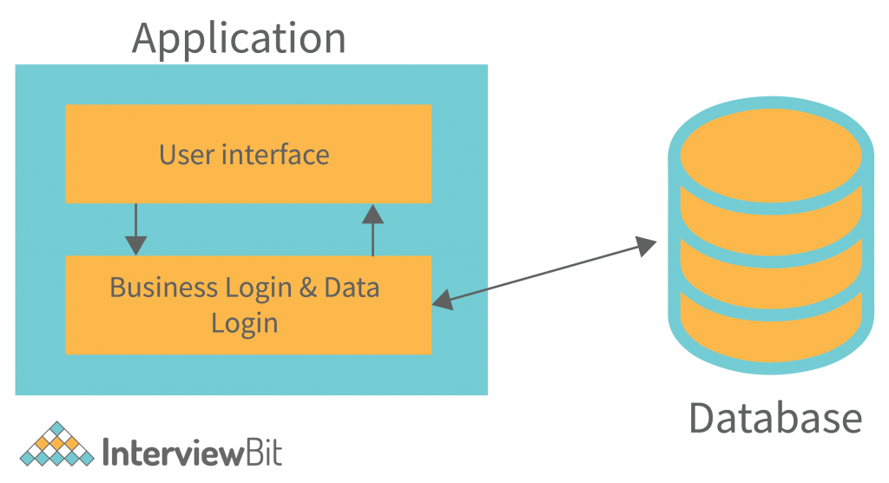
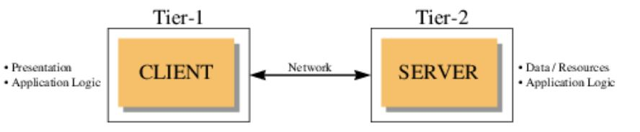
Advantages:
Simple and fast for small applications
Fewer components make it easy to deploy
Good performance with low network overhead
Disadvantages:
Not scalable for large user bases
Tight coupling between UI and logic
Updating business logic means redeploying the whole client app

Slide 8
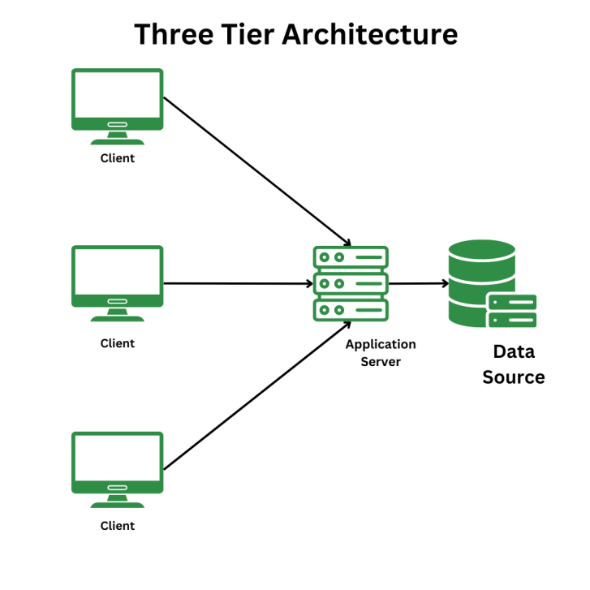
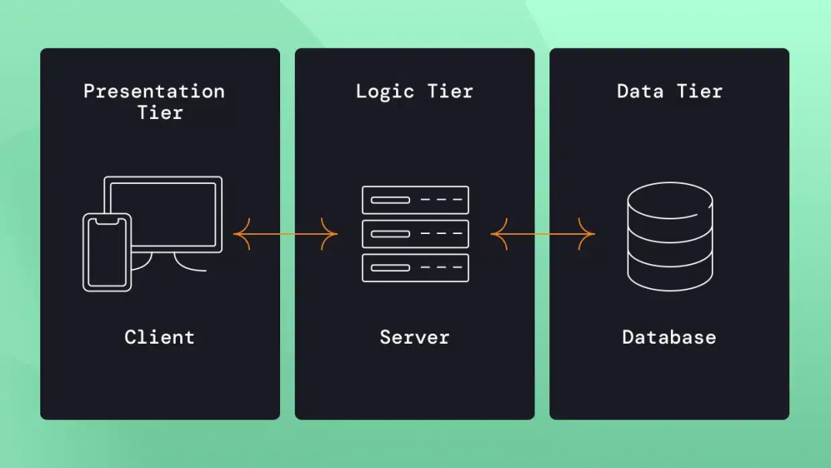
Three Tier Architecture:
  Three-tier architecture divides an application into three logical layers, each with a specific responsibility:
    Presentation Layer (UI) or First tier - The user interface where the end-user interacts with the system (e.g., a web browser or a mobile app).
    Business Logic Layer (BLL) or Second tier - handles the application’s core processing, business rules, and calculations.
    Data Layer (Database) or Third tier - Manages the storage, retrieval, and manipulation of the application’s data, typically utilizing a database.
  This separation makes the application modular, scalable, and maintainable.

Slide 9
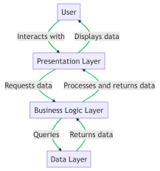
How does a 3-tier application architecture work?
User Interaction: The user interacts with the presentation tier (e.g., enters data into a web form or clicks a button on a mobile app).
Request Processing: The presentation tier sends the user’s request to the application or Business logic tier.
Business Logic: The logic tier executes the relevant business logic, processes the data, and potentially interacts with the data tier to retrieve or store information.
Data Access: If necessary, the application tier communicates with the data tier to access the database, either reading data to be processed or writing data for storage.
Response: The logic tier formulates a response based on the processed data and business rules and packages it into the expected format the presentation tier requires.
Display: The presentation tier receives the response from the application tier and displays the information to the user

Slide 10
N-tier architecture:
  N-tier architecture extends the concept of 3-tier by dividing the application into more than three distinct layers.
  Each tier has a specialized responsibility, and the number “N” simply means any number of tiers.

Slide 11
It can be distributed into following layers:
User Interface: The layer where end-users interact with the system, such as through a web browser or mobile application.
Presentation Logic: Responsible for defining what is displayed to the user and how their requests are processed.
Business Logic: Handles the core processing of the application, including business rules, workflows, and calculations.
Infrastructure Services: Provides additional support functions such as messaging, logging, authentication, and transaction management.
Data Layer: Manages data storage and retrieval from databases or other persistent storage systems.

Slide 12
Advantage | Benefit Description
Separation | Clear modular responsibilities
Scalability | Allows you to add new components without effecting the performance of the existing application.
Reusability | Shared services and business logic across platforms
Maintainability | Easy updates without impacting the entire system
Security | Controlled access between layers
Load Distribution | Balanced performance and reduced bottlenecks
Cloud Readiness | Suitable for modern distributed systems. Ex: Micro services architecture

Slide 13
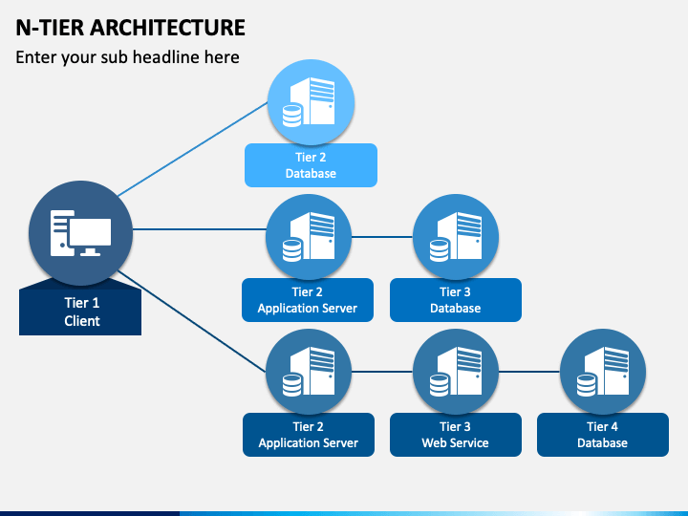
Summary

Slide 14
Objectives of Enterprise applications:
The following objectives need to be taken into account while developing enterprise-based solutions:
  Robustness: Develop an application that is reliable and bug-free to ensure consistent performance and meet user expectations effectively.
  Enterprise application must be scalable - ensures it can handle increased user load efficiently
  Ensuring that object oriented design principles are implemented in an enterprise application.
  Avoid unnecessary complexity in enterprise applications by choosing simple, effective solutions that meet real requirements without over-engineering.
  Ensure that each component in an enterprise application has a clear, independent responsibility to support easy maintenance and reduce tight coupling.

Slide 15
- Ensure that an enterprise application aligns with the organization’s long-term strategy by promoting code reusability and minimizing duplication through effective object-oriented design.
- Design enterprise applications with testing in mind to simplify the process, as testing is a critical activity throughout the software life cycle.
- Depending on business requirements, an enterprise application may need to support multiple client types and ensure portability across databases and application servers for broader usability and flexibility.

Slide 16
Describing JAVA EE6 Containers
In Java EE6 (Java Platform, Enterprise Edition 6), the Enterprise Edition (EE) Container is a runtime environment that provides core services and manages the lifecycle, security, transactions, and deployment of Java EE components.
A component in Java EE is a software unit that performs a specific function within an enterprise application. Components are managed by containers and can be either part of the client-side or server-side of the application.

Slide 17
Ex: Web component
@WebServlet("/greet")
public class GreetingServlet extends HttpServlet {
public void doGet(HttpServletRequest req, HttpServletResponse res) {
res.getWriter().println("Hello from a web component!");
}
}
This servlet is a web component, managed by the web container, and handles HTTP requests.
JAVA EE allows declarative programming.
Declarative programming is a programming paradigm where you describe what you want to do, rather than how to do it (which is done in imperative programming).
Ex: :
Imperative: "Do this, then this, step-by-step."
Declarative: "This is the outcome I want — system, handle the rest."
  SELECT name FROM students WHERE grade > 90;
  You say what you want — not how the database should loop or access records.

Slide 18
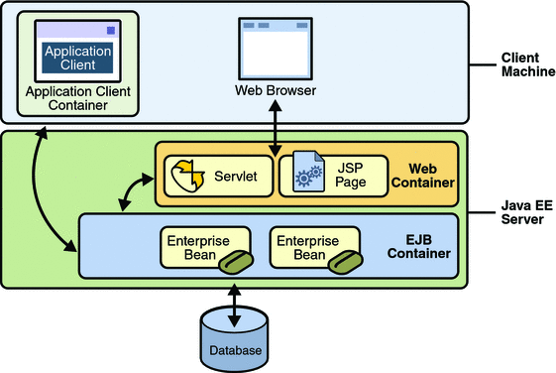
Container Types:
Web container— Allows you to execute all JSP pages and servlet components for a Java EE application. Web components and their containers run on the Java EE server.
EJB container— Allows you to execute all enterprise beans for a Java EE application. Enterprise beans and their containers run on the Java EE server.
Application client container— Application clients and their containers run on the client machine and they will interact server side components from the client.
Applet container— Allows you to execute an applet. The Applet container is a combination of the Web browser and Java Plug-in, running together on the client machine. [DEPRECATED]

Slide 19
// In CustomerClient.java
import javax.naming.InitialContext;
import com.example.CustomerService; // Remote interface of the EJB
public class CustomerClient {
public static void main(String[] args) throws Exception {
I nitialContext ic = new InitialContext();
// Look up the remote EJB
CustomerService customerService = (CustomerService) ic.lookup("java:global/YourApp/CustomerServiceBean!com.example. CustomerService");
// Invoke a method on the EJB
customerService.addCustomer("John Doe");
System.out.println("Customer added.");
}
}
The container handles:
  JNDI Lookup: Allowing the client to find the remote CustomerServiceBean using JNDI.
  Remote Method Invocation (RMI): Facilitating the communication between the client and the EJB on the server.
  Resource Management: Potentially managing connections and other resources needed by the client.

Slide 20
JAVA EE6 Container Architecture
Container itself is divided into four parts:
  Component contract,
  Container service APIs,
  Declarative services
  Other container services

Slide 21
Component Contract
  Component contracts are rules, which application components must extend or implement.
    Ex: Java Thread is required to extend the Thread class or Implements Runnable interface.
    If thread application does not use above, the JVM can not call the life cycle methods of thread.

Slide 22
Container Service APIs
  A Container Service API is a set of Java EE interfaces and classes provided by the container that lets your component access services like:
    Transactions
    Security
    Messaging
    Dependency Injection
    Web services, etc.
  Imagine you're living in an apartment (component) inside a housing society (container). You don’t build your own electricity, plumbing, or security — the society provides them.
  Those facilities = Container Services.
  How you access them = Container Service APIs.

Slide 23
Declarative Services
  Instead of writing code, the component declares services it wants, such as:
    Security (@RolesAllowed)
    Transactions (@TransactionAttribute)
    Resource injection (@Resource, @EJB)
  These are declared using annotations or XML deployment descriptors.
  The container interprets and applies these at runtime.
Manual Coding | Declarative (Automatic via Annotation/ XML)
You write code to control behavior | You declare behavior and let the container handle it
tx.begin(); tx.commit(); | @TransactionAttribute(TransactionAttributeType.REQUIRED)
connection = datasource.getConnection() | @Resource DataSource datasource

Slide 24
Service Type | Annotation or XML | What It Does
Security | @RolesAllowed("Admin") | Only allows users with role "Admin" to access the method
Transactions | @TransactionAttribute(TransactionAttributeType.REQUIRED) | Tells the container to manage transactions
Resource Injection | @Resource(name="jdbc/MyDB") | Tells container to inject a DataSource
EJB Access | @EJB | Injects a reference to an enterprise bean

Slide 25
Example:
@WebServlet("/hello")
public class HelloServlet extends HttpServlet {
@Resource(name = "jdbc/MyDataSource")
private DataSource dataSource;
protected void doGet(HttpServletRequest request, HttpServletResponse response) throws IOException {
response.getWriter().println("Hello from Servlet!");
}
}
Part | How It Appears in the Example
1. Component Contract | extends HttpServlet ⇒ This is the contract that all servlets must follow.
2. Container Services API | HttpServletRequest, HttpServletResponse, DataSource ⇒ Provided by the web container.
3. Declarative Services | @WebServlet("/hello"), @Resource(name = "jdbc/MyDataSource") ⇒ Declared using annotations.
4. Container Provider Implementation {Other services} | GlassFish, Tomcat, WildFly, etc., run this servlet and provide actual logic for HTTP handling, DI, etc.

Slide 26
Ex: web.xml
    <web-app >
    <servlet>
    <servlet-name>HelloServlet</servlet-name>
    <servlet-class>HelloServletClass</servlet-class>
    </servlet>
    <servlet-mapping>
    <servlet-name>HelloServletClass</servlet-name>
    <url-pattern>/hello</url-pattern>
    </servlet-mapping>
    </web-app>

